Slide 1
Unified View of Agent
Delivery Plan
06/07/2020

Slide 2
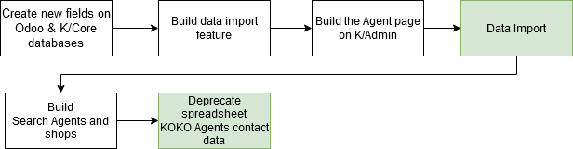
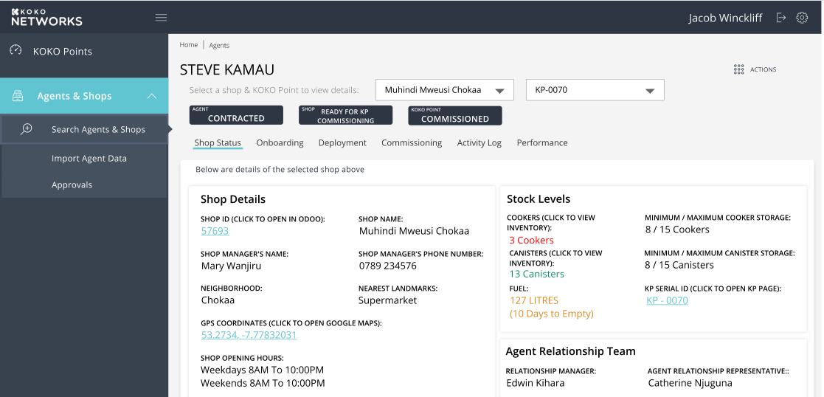
Delivery Plan
Data Migration Phase

Slide 3
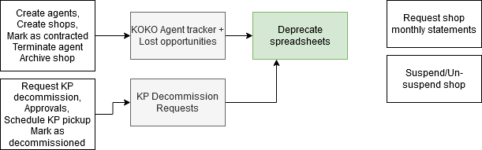
Delivery Plan(..continued)
Ongoing Management Requirements

Slide 4
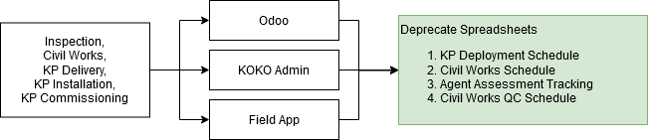
Delivery Plan(..continued)
Deployment Requirements

Slide 5
Delivery Plan(..continued)
Future Work:
Field App for Agent Network team to capture new opportunities.

